Slide 1

Library Management System
Modern Library Management Made Simple
Java-Based Solution for Academic Libraries
Developed by: Chandra Prakash GitHub : Library System

Slide 2

System Architecture
A three-tier architecture designed for scalability, security, and efficient library operations across student and librarian workflows.
Database Layer
SQL storage, transactions, and persistence services
Book Management
Cataloging, circulation, reservations, and APIs
User Management
Students & Librarians access and workflows
Core Technologies: Java | SQL Database | Object-Oriented Design

Slide 3

Key Features
📚 Book Management
👥 User Management
Add and remove books from inventory
Separate student and librarian accounts
Real-time stock updates
Secure password authentication
Track issue and return status
Automated fine calculation
Role-based access control
Complete user profile management

Slide 4
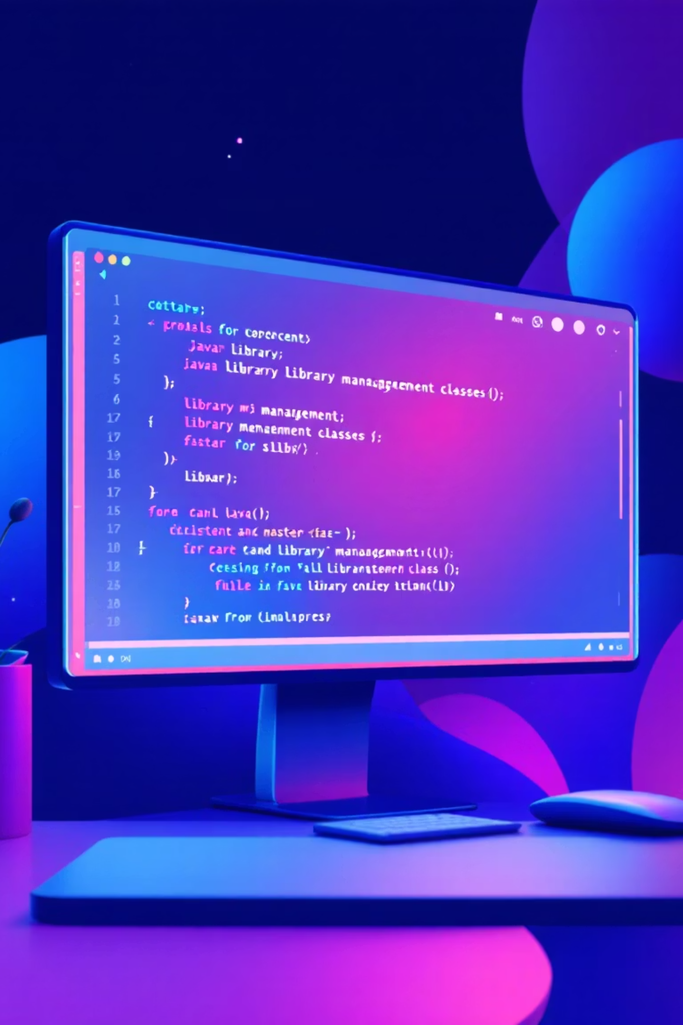
Technical Implementation
The system follows object-oriented principles with a modular structure for maintainability and extensibility.
Core Components
1
Book.java | Student.java | Librarian.java | Library.java
Data Persistence
2
DatabaseManager.java handles all SQL operations securely
Business Logic
3
Enforces 7-day issue period and ₹10/day fine system

Slide 5

System Workflow & Benefits
Streamlined processes ensure efficient library operations with complete transparency and real-time updates.
01
02
03
Book Issue
Return Management
Fine Settlement
Students request books; system validates availability and logs the transaction
System records return date and calculates applicable fines if overdue
Automated fine calculation at ₹10 per day over 7-day issue period
⚡ Automated Operations
📊 Real-Time Updates
🔐 Secure Access
Eliminates manual tracking errors
Instant visibility into inventory
Role-based permissions protect data

Slide 6

Thank You
NotChandraPrakash/library-management-system
Simplifying library operations through technology

